Slide 1


FY2027 PROPOSED
SCHOOL BOARD BUDGET
“Deep Roots, Greater Heights”
PUBLIC HEARING
Christie Fleming, Chief Finance Officer
Dr. Kari Weston, Superintendent
April 28, 2026

Slide 2



Public Schools Matter
Public schools are essential to communities, serving as vital hubs that drive economic growth, foster social cohesion, and prepare an informed citizenry for a democratic society. They enhance local prosperity by increasing property values, provide a safe, inclusive learning environment for all children, and offer essential community services like healthcare, adult education, and extracurricular activities. Public education is associated with healthier, longer lives, reducing the long-term public burden on social services, and community health.

Slide 3
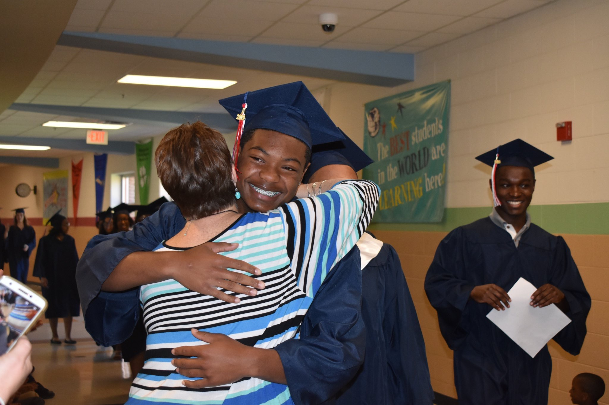

The WHY

Slide 4

What is our
for the future?

Slide 5
We cherish our heritage, embrace opportunity, and offer an extraordinary community in which to spend a lifetime.
Together, we grow a trailblazing school system where every student is equipped to thrive - in college, career, community, and character. DCPS graduates are resilient, ethical, skilled, and opportunity-ready, with a plan for lifelong success.

Slide 6
Community Survey
Top 3 valued attributes:
rural character, sense of community, and its education system
Top 3 concerns:
availability of broadband and internet services, quality of public schools, and the County’s development, population, and growth
Top 3 focus areas for the future:
‘improving utilities and infrastructure (including broadband), improving public schools, and creating parks and recreation opportunities

Slide 7
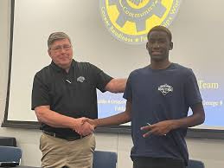
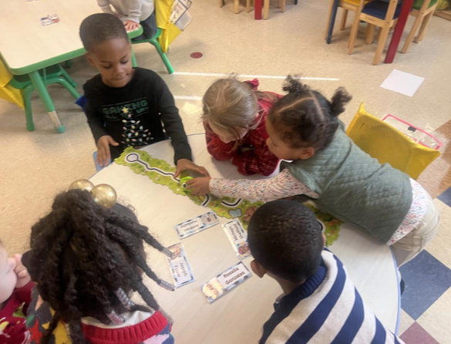
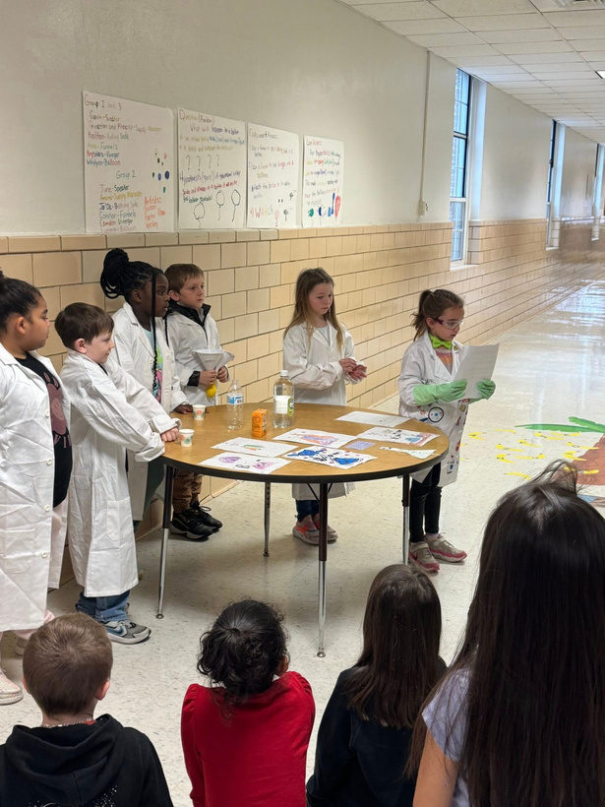
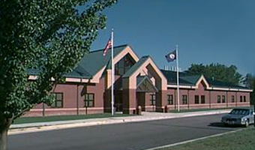
Budget Survey Results &
DCPS Strategic Planning
Needs Assessment
Top 4 focus areas for the future:
Student Achievement & Opportunities
Excellent Teachers
Culture of Care & Well-Being
Updated Facilities

Slide 8


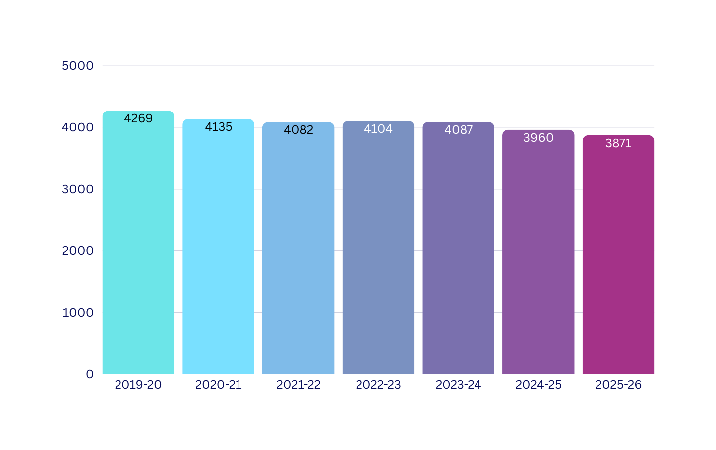
ADM - Enrollment

Slide 9












Personalized Learning
RISE Program
Early Learning
Private Day
College Credit Courses
Virtual Learning
Encompass Learning Center
Chesterfield Recovery Academy
GED - Students and Adults
Keys Academy
Accelerated Opportunities

Slide 10
Our Enhanced Vision & Mission
Deep Roots, Great Heights.
Our mission and vision are shaped by a legacy of support, a culture of care, and a belief that when families, educators, and community partners come together, there is no limit to how high our students can soar.
Mission Statement
Rooted in community, grounded in care, and committed to every child’s growth, Dinwiddie County Public Schools cultivates learners to become confident, compassionate, and prepared to reach great heights in life beyond graduation.
Vision Statement
Together, we grow a trailblazing school system where every student is equipped to thrive - in college, career, community, and character. DCPS graduates are resilient, ethical, skilled, and opportunity-ready, with a plan for lifelong success.

Slide 11

Students
Budget Priorities
The purpose of school budget priorities is to strategically allocate limited school funds towards programs and initiatives that are considered most essential for achieving the system’s educational goals, ensuring that resources are directed where they will have the greatest impact on student success, and prioritizing needs based on their importance to student learning.
Staff
u
Operations

Slide 12


SOQ Funded Positions
663 Total Employees
427 Instructional Positions
340 SOQ Instructional Funded
236 Support Positions
131 SOQ Support Funded

Slide 13
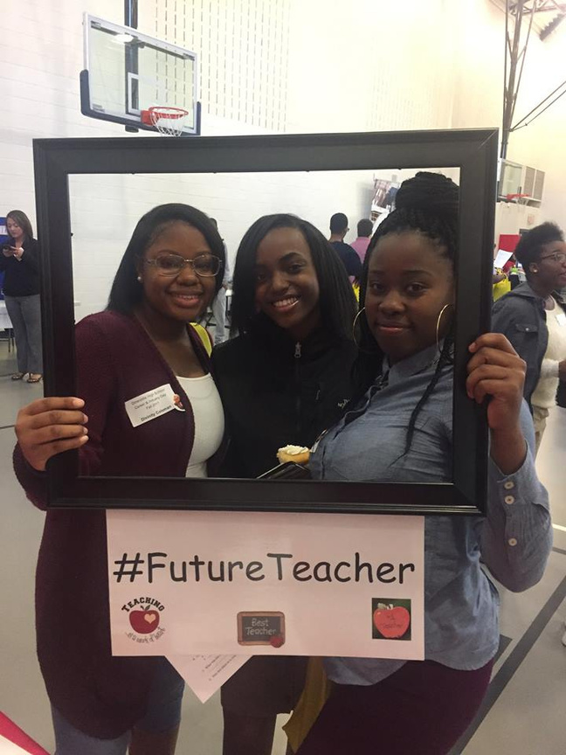

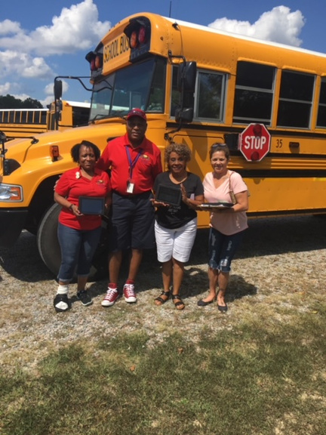
Priority: Staff Compensation
Increase for all employees - $2,169,756
Teachers - 5% - 8.65% - $1,617,270
Bus Drivers - FT Starting at $25/hour
5% - 32.51% - $337,589
UPP - Starting $13.71/hour
5% - 5.15% - $622,370

Slide 14
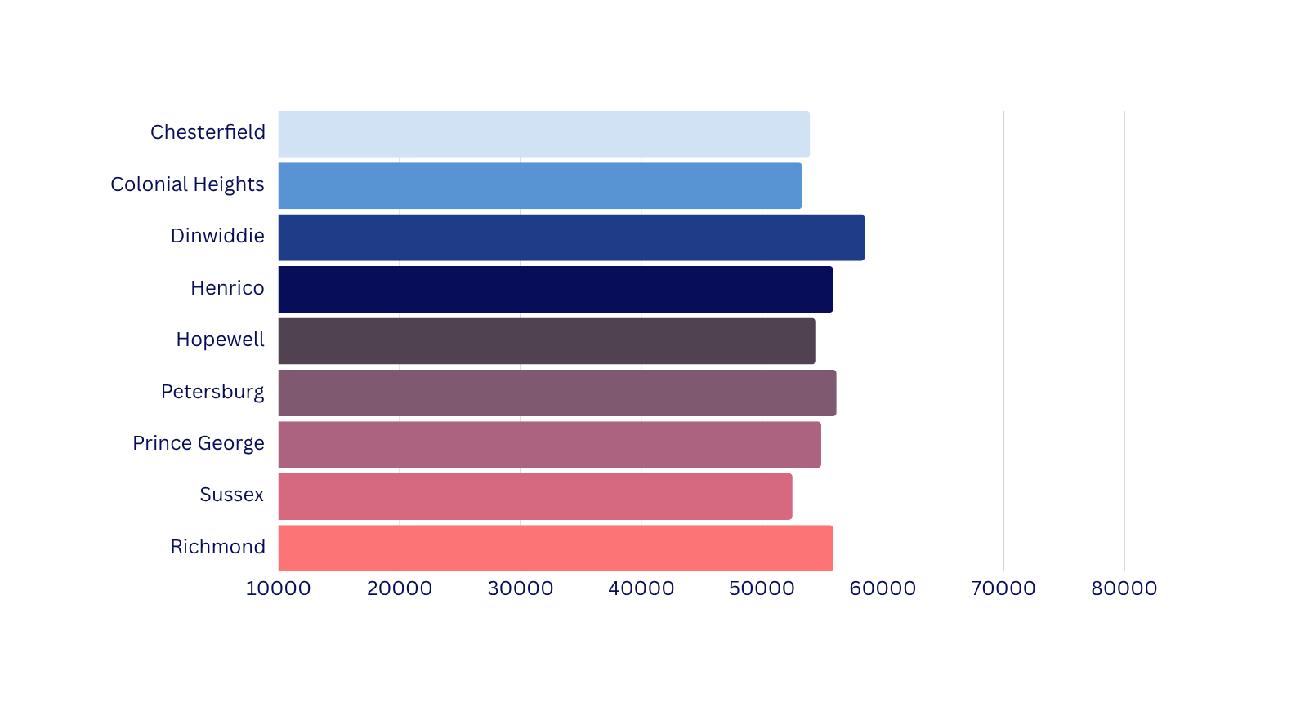
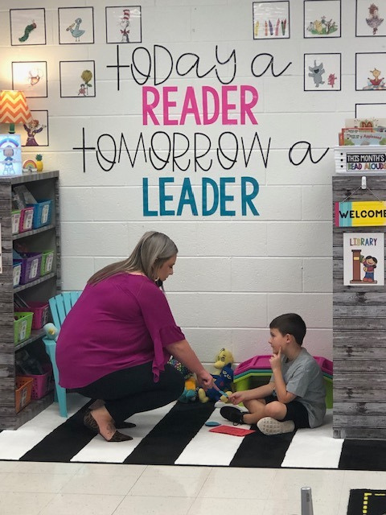
Beginning Teacher Salary - Proposed $58,500
Region 1

Slide 15
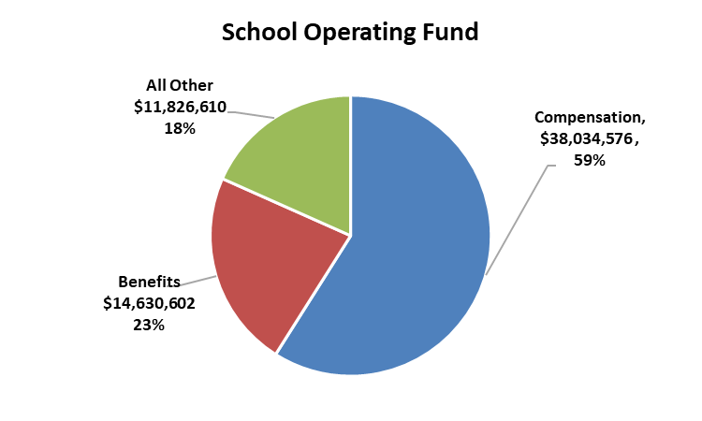
Employee Benefits
Includes:
FICA (Social Security)
Virginia Retirement System
Group Life Insurance
Health Insurance
Retiree Health Care Credit
Hybrid Disability
Employee Benefits make up 23% of the School Operating Budget
Health Insurance has increased 87.3% since FY2019

Slide 16
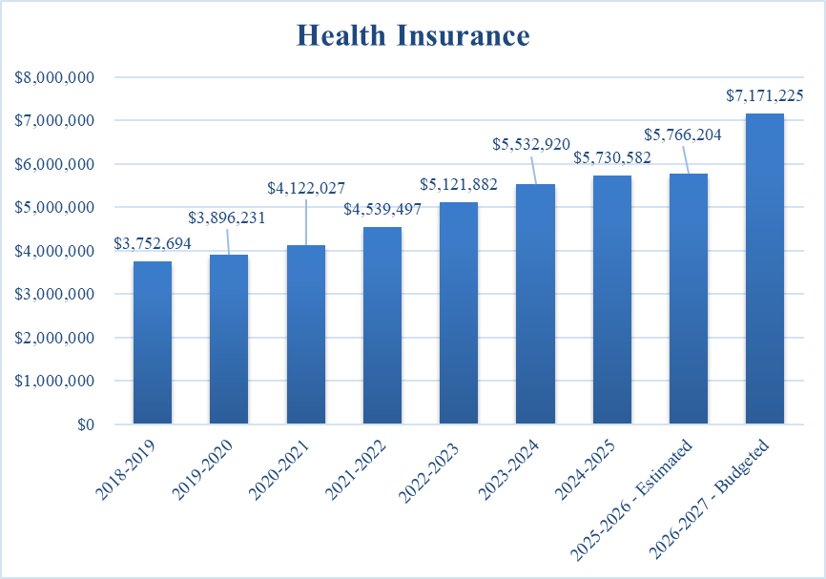
Employee Benefits

Slide 17
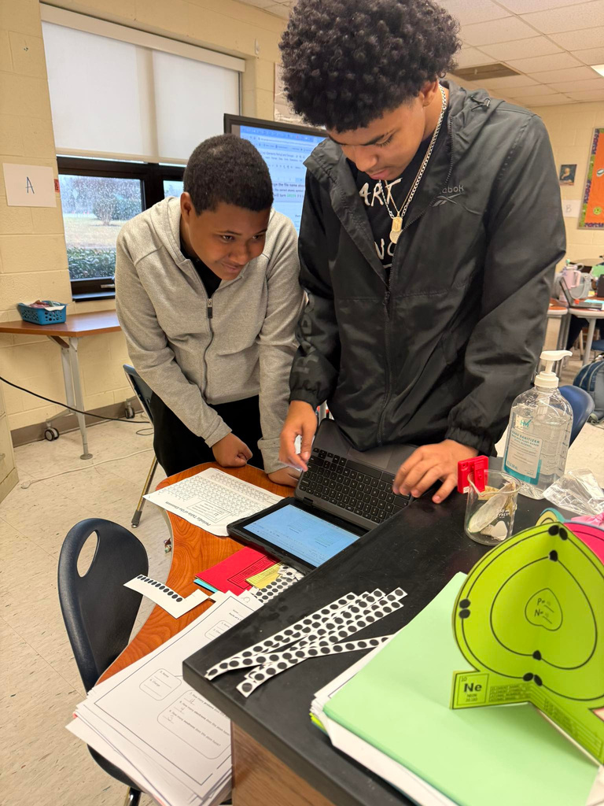
Required Increases
Tuition
Employee Compensation
Instructional Academic Supplements
Contracted Services
Custodial
Building Maintenance
Landscaping Services
Contracted Health Services (Exceptional Education)
Radios contract with Dinwiddie County
Utilities
*Health Insurance +12.5%

Slide 18

Priority: Student Achievement & Opportunities
Tuition
Regional Programs
Brightpoint Community College
Positions
Additional Teachers - K, 1, & 5
Autism Teacher
Early Learning
Student Support Specialist - Attendance
Reclassification - 10.5 months (4)
Instructional Specialists for Exceptional Education
School-based
Academic Stipends

Slide 19
Adjustments since Presentation to the County
Additional Revenue - $779,718 (Pending General Assembly Adoption)
Increased ADM by 25 Students - 3875 - $269,695
Included state share of 3% increase proposed by the GA - $253,667
Included partial funding for At-Risk and Exceptional Education proposed by the GA - $414,991
Decreased local transfer by $158,635 to $650,000 in new funding
Expenditure Adjustments
Health Insurance - DCPS paying full increase - no cost to employees
Positions
Additional Teachers - K, 1, & 5
Eliminated Vacant Positions
Midway Gym Floor Asbestos Removal - (Included in County CIP)
Materials & Supplies

Slide 20
Governor’s Budget and Proposed General Assembly Actions
1st Year of the Biennium
Enrollment: 3875
SOQ Programs $3,341,818
Lottery Funded Programs $1,612,399
Incentive Programs <$2,404,683>
Categorical Programs <$114,572>
Other State Funds <$60,509>
Total Increase in State Revenue $2,374,453

Slide 21
State Revenue Over Time
State Funding Increases to DCPS
Based On:
FY21: $31,864,457 4,250 Students
FY22: $33,294,935 (4.49%) 4,150 Students
FY23: $36,870,718 (10.74%) 4,100 Students
FY24: $38,567,332 (4.6%) 4,100 Students
FY25: $44,025,957 (14.15%) 4,100 Students
FY26: $44,140,710 (.32%) 3,975 Students
*FY27: $46,515,162 (5.38%) 3,875 Students
*Includes Proposed Changes

Slide 22
*State Funding and Compensation Increases
State SOQ-funded pay raises:
FY21: 0%
FY22: 5%
FY23: 5%
FY24: 5%
FY25: 3%
FY26: 3%
FY27: 2% (Gov ; GA - 3%)
Dinwiddie Teacher Raises:
FY21: 0%
FY22: 5 - 7.6%
FY23: 7.3 - 9.96%
FY24: 5 - 6.84%
FY25: 5%
FY26: 3%
FY27: 5% - 8.65% (Proposed)
*Excludes any one-time funding or bonuses

Slide 23

FY 27 Total County Request - Fund 205
Based on Governor’s Budget and Proposed General Assembly Actions
Requested $808,635 (NEW FUNDING)
to Support ½ Teacher Increase
*Approved increase in Local Transfer From County = $650,000

Slide 24
Local Transfer Over Time
Fund 205
*FY21: $15,182,488 + $0 (0%)
*FY22: $15,690,100 +$507,612 (3.3%)
*FY23: $15,990,100 +$300,000 (1.9%)
*FY24: $16,190,100 +$200,000 (1.3%)
*FY25: $16,190,100 +$0 (0%)
*FY26: $16,690,100 +$500,000 (3.0%)
*FY27: $17,340,100 (Proposed) +$650,000 (3.9%)
Local Composite Index: .3186 (+.0208)
*Excludes small & large capital improvement funding

Slide 25

Other Revenue Sources (Operating Budget)
Local Revenue
New Story $240,876
Driver’s Education Fees $ 5,000
Chromebook Insurance $ 40,000
Vision Grant $ 11,000
Total $296,876
Federal (Medicaid, JROTC, eRate) $339,650

Slide 26

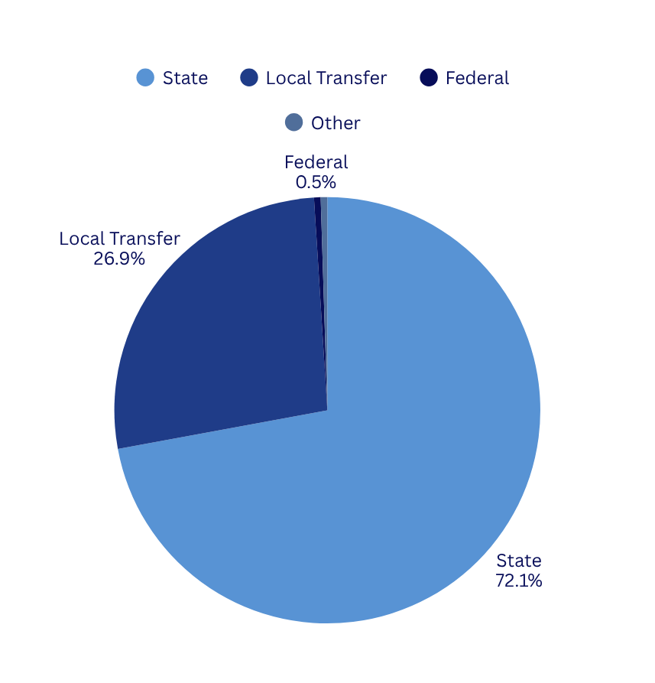

Revenue Summary
State :
$46,515,162
Local Transfer
$17,340,100
Federal
$339,650
Other
$296,876

Slide 27
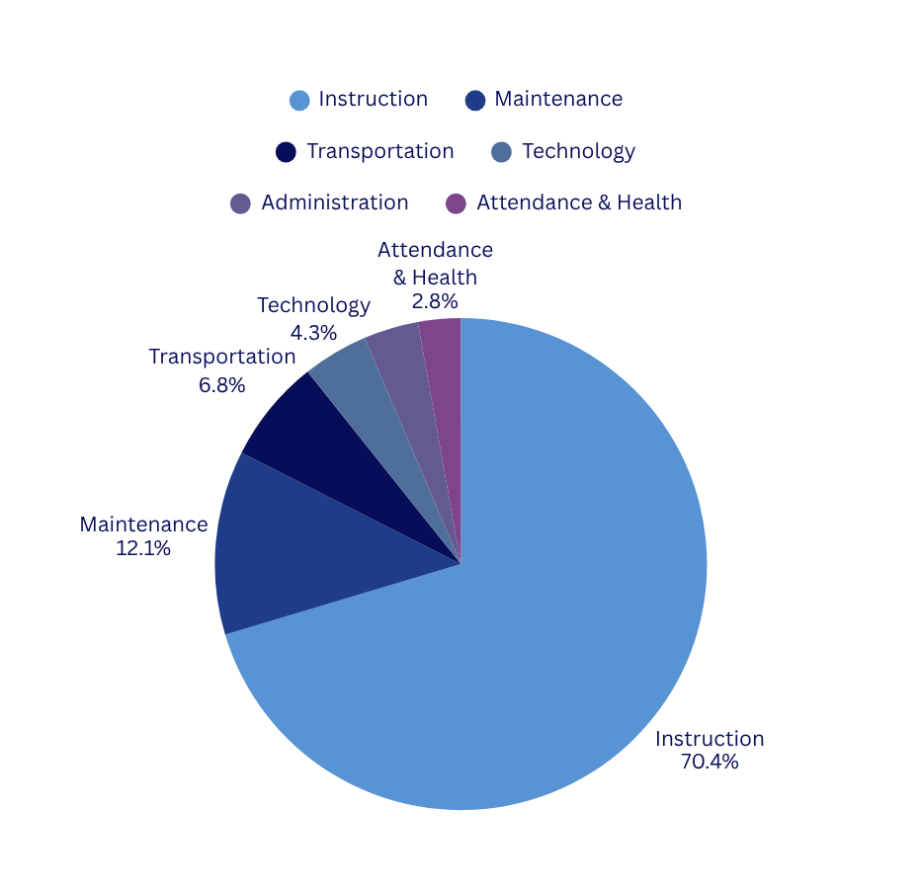






Expense Summary
Instruction:
Technology
$45,292,140
$2,845,434
Maintenance
Administration
$7,845,037
$2,309,095
Transportation
Attendance &Health
$4,409,744
$1,790,338

Slide 28

FY2027 SCHOOL OPERATING
FUND 205
Beginning Balance 07.01.26 (Projected) | $ 0
Total Revenues | $64,491,788
Total Expenditures | $64,491,788
Ending Balance 06.30.27 (Projected) | $ 0

Slide 29
FY 27
Small Capital Projects
Fund 302

Slide 30
FY 27 Total County Request - Fund 302
Based on Governor’s Budget
Fund 302 Small Capital Projects
$300,000 (Maintain)
County CIP - 10 Year
$142,800 - Midway Gym Floor
Bus Replacement
$397,838
Total Request - $840,638

Slide 31

Small Capital
Maintain capital transfer of $300,000
Fleet Management Plan
Small Capital Projects
Painting Schedule
Furniture Replacement

Slide 32

On-Going Projects
Midway Auditorium Renovation
Annex Roof Replacement
DES Soffitt Repair
Tennis Court Resurfacing
These projects were funded in a previous year, but will have expenditures in FY27

Slide 33

FY2027 SCHOOL CAPITAL
FUND 302
Beginning Balance 07.01.26 (Projected) | $ 5,658,409
Transfer from County Fund | $ 540,638
Proposed Small Capital Project Revenue | $ 300,000
Transfer from School Fund FY26 EOY | $
Proposed Total Expenditures | $ 5,238,588
Estimated Ending Balance | $ 1,260,459
9

Slide 34
FY2027 TEXTBOOKS
FUND 206
Beginning Balance 07.01.26 (Projected) | $1,088,617
Transfer from School Fund | $ 195,534
State Revenue | $ 418,195
Total Expenditures | $ 1,145,323
Ending Balance | $ 557,023
Consumables
E-textbooks
Software
Adoption

Slide 35

FY2027 SCHOOL NUTRITION
FUND 207
Beginning Balance 07.01.26 (Projected) | $ 708,982
Total Revenue | $ 3,112,534
Total Expenditures | $3,469,425
Ending Balance | $ 352,098
Includes federal, state, & local funding
5% Salary Increase
food, supplies, repair & maintenance
6

Slide 36
FY2027 SCHOOL GRANTS
FUND 303
Beginning Balance 07.01.26 (Projected) | $ 556,279
Transfer from School Fund | $ 469,945
Federal, State, & Other Revenues | $ 5,201,914
Total Expenditures | $ 5,971,642
Ending Balance | $ 256,496
Title I, Title II, Title III, Title IV, Title VIB, Special Education Preschool
Early Reading, Virginia Preschool Inititave, Project Graduation, Security

Slide 37
FY2027 DEBT SERVICE
FUND 402
Beginning Balance 07.01.26 (Projected) | $ 3,244,356
Total Revenue | $ 3,844,704
Total Expenditures | $ 3,290,608
Ending Balance | $ 3,798,452

Slide 38
FY2027
SUMMARY OF ALL FUNDS
Beginning Balance 07.01.26 (Projected) | $ 11,256,643
Total Revenues | $ 78,575,252
Total Expenditures | $ 83,607,374
Ending Balance | $ 6,224,521
13

Slide 39
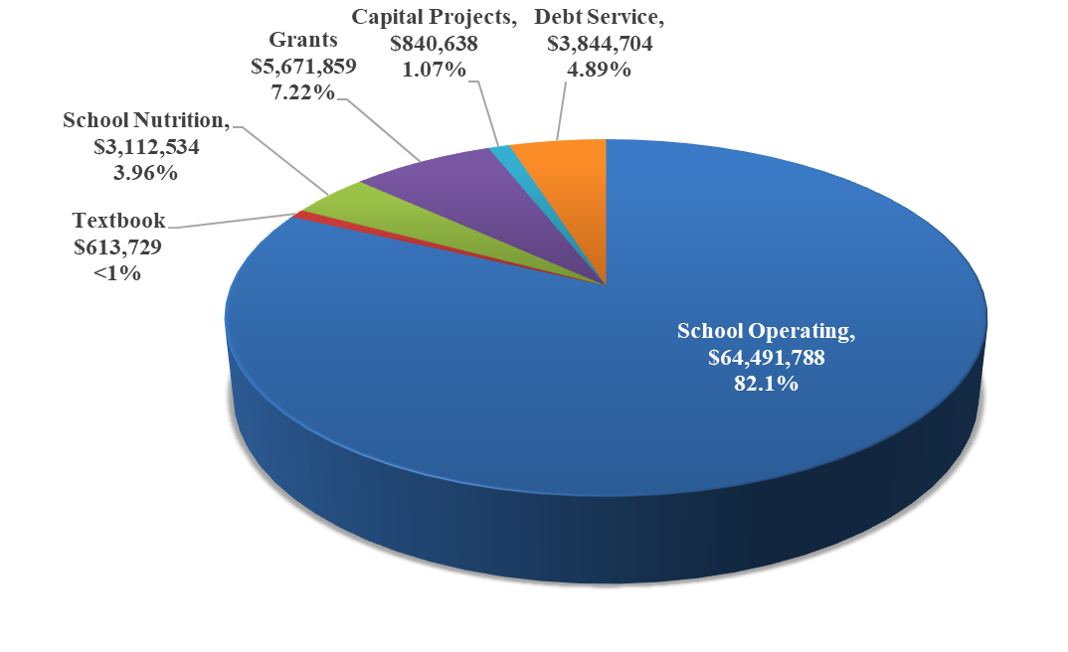
FY2027
TOTAL REVENUES

Slide 40
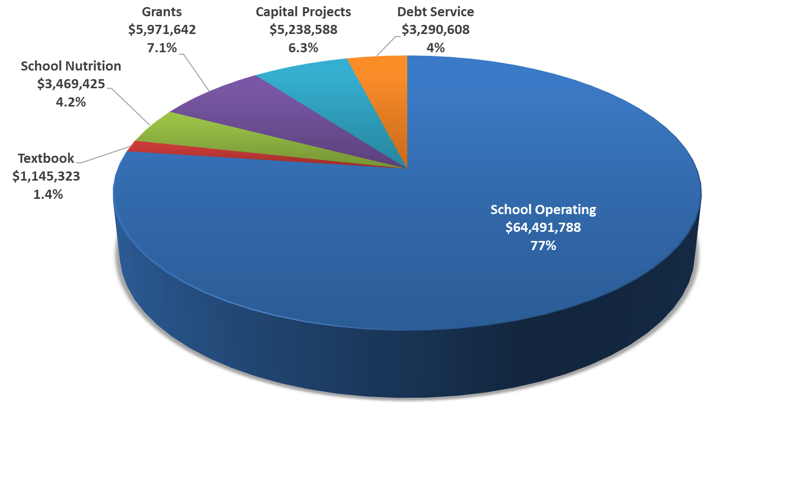
FY2027
TOTAL EXPENSES

Slide 41
Next Steps
General Assembly - Final Budget
County Approval - May 5th
School Board Approval - May 12th

